Slide 1
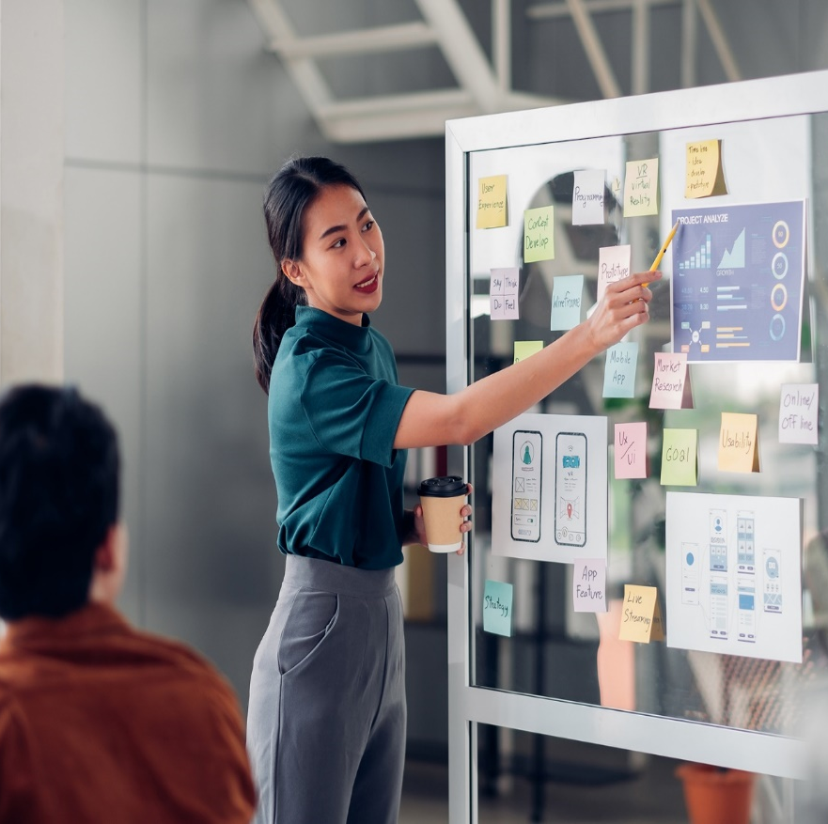
CivicPlus-UST Product Engineering
Team Ironman - Offshore team for Civic
Engage Central.
Team Sentinels- Offshore team handles
automation and releases for multiple products.
Team member actively supporting and collaborating with the onshore Herald team.

Slide 2
Current Week
Associate Name | Duration (Days) | Dates

Slide 3
Leaves Planned
Associate Name | Duration (Days) | Dates
Saurabh Sawant | 3 | 29th to 31st July

Slide 4
Open Action
Risk / Issue
Team | Risk/Issue | Details | Owner | Status
Iron Man | Production data access​ | All Developers has access to production data. We recommend to restrict the access to production data to key developers and provide the need basis access to production to avoid any data security issues. | Civic Plus | Open

Slide 5
UST Holiday Calendar - 2026
No
1
2
3
4
5
6
7
8
Sr. No. | Company Holiday | Date(dd-mm-yyyy) | Day
1 | Republic Day | 26th Jan 2026 | Monday
2 | Holi | 3rd Mar 2026 | Tuesday (Pune location only)
3 | Ugadi | 19th Mar 2026 | Thursday (Bangalore location only)
4 | Idul Fitr/Gudi Padwa | 20th Mar 2026 | Friday
5 | Maharashtra Day | 1st May 2026 | Friday
6 | Spring bank holiday | 25th May 2026 | Monday(UK)
7 | Summer bank holiday | 31th August 2026 | Monday(UK)
8 | Ganesh Chaturthi | 14th Sept 2026 | Monday

Slide 6
UST Holiday Calendar - 2026
No
1
2
3
4
5
6
7
8
Sr. No. | Company Holiday | Date(dd-mm-yyyy) | Day
8 | Gandhi Jayanti | 2nd Oct 2026 | Friday
9 | Dussehra(Mahanavami) | 20th Oct 2026 | Tuesday
10 | Christmas | 25th Dec 2026 | Friday
11 | Boxing Day (substitute day) | 28th Dec 2026 | Monday(UK)
12
13
14
15

Slide 7
UST Product Engineering

